Slide 1

Banking Correspondent/Facilitator exam
Registration-Examination-Certification
Prepared by – CSC e-Governance Service India Limited
Version: 1.0
Date:30-05-2019

Slide 2
MoU Between IIBF and CSC e-Governance Service India Limited
A MoU with IIBF for conducting examination under Banking Correspondents Course has been signed dated 26th April 2019.
As per the agreement, CSC VLEs can be enrolled and can enrol others for the BC examination for which the examination fee will be paid using CSC wallet. The fee is decided by IIBF
CSC VLEs can charge facilitation charges of 30 Rs. (Exclusive GST) for filing the registration form.
CSCSPV will be paid 175 Rs +GST for conducting exam

Slide 3
BC/F exam through CSC
Objective: To appear for BC/BF exam
Who can attempt/apply: Any one interested to become Banking correspondent or want to impart banking services.
What is fee: 800+ GST for attempt number 1st, 3rd ,5th and on; 400+GST for attempt number 2nd , 4th , 6th and so on
How many attempts, one can take: Multiple times until get passed by paying fees.
Who is certifying Agency : IIBF
What is benefits for applying through CSCs: Exam venue will be nearby to you and as per your conveyance

Slide 4
How to Register
Visit to Digital Seva Portal and Click on Service “BC/F certification” (Examination Fee)
CSC’s Exam Centre List is available at
https://iibf.esdsconnect.com/CSCNonreg/member/?Mtype=Tk0=&ExId=OTkx

Slide 5
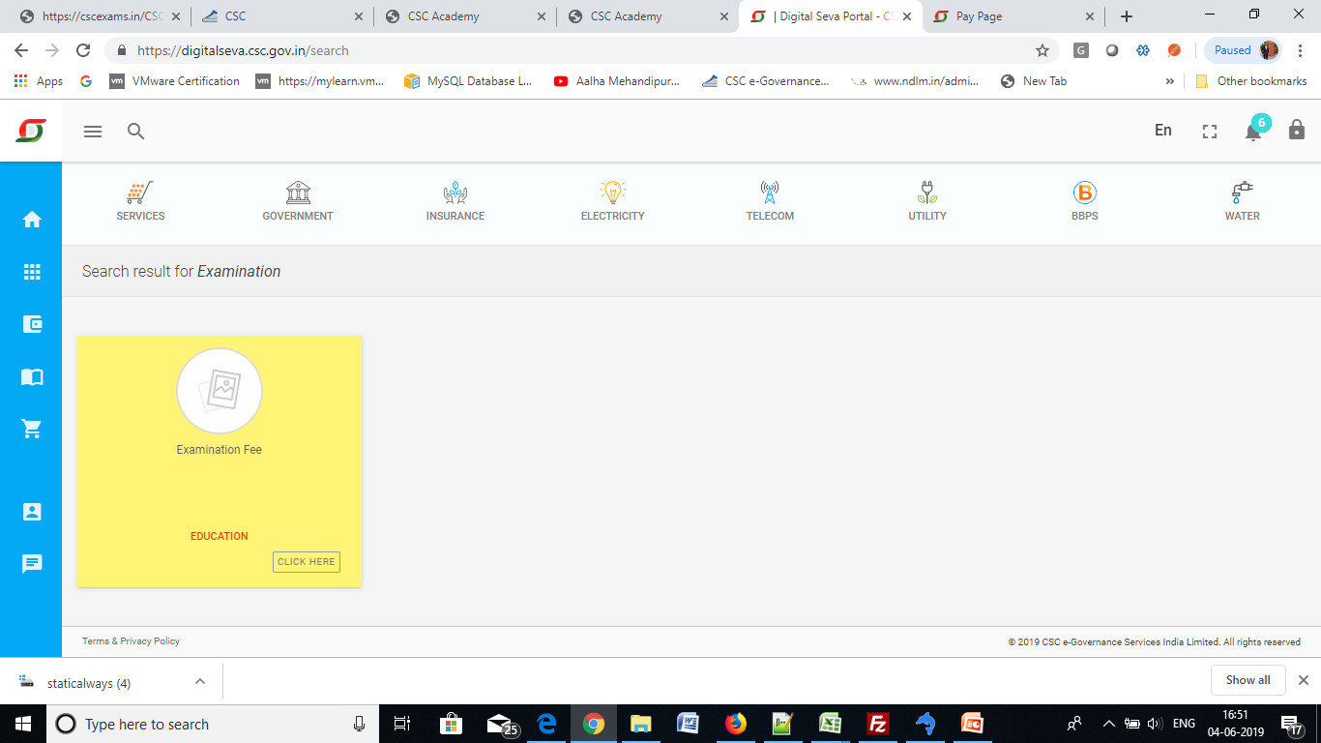
Service at Digital Seva Portal

Slide 6
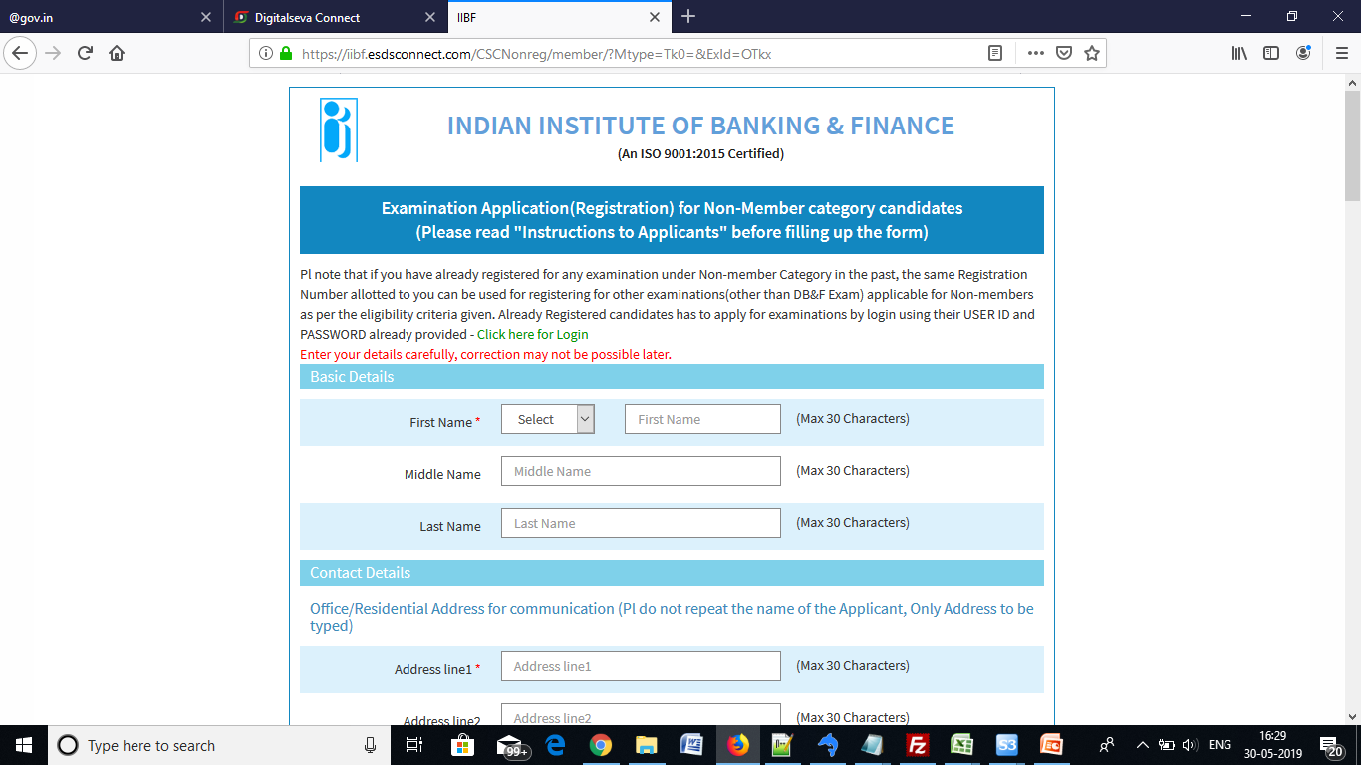
Provide Basic Details

Slide 7
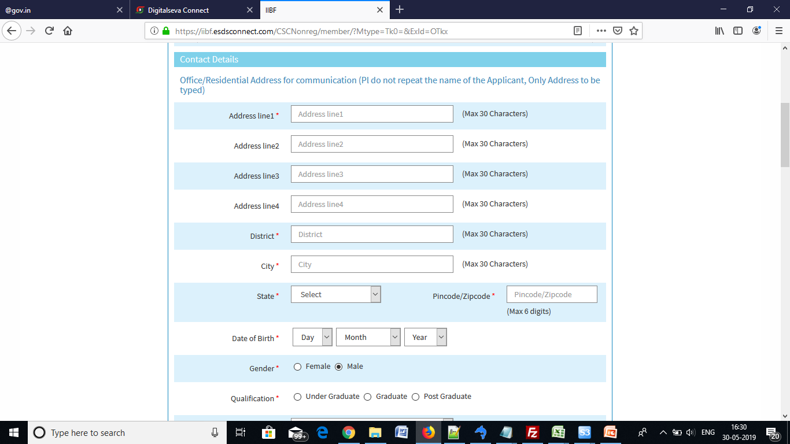
Provide Contact Details

Slide 8
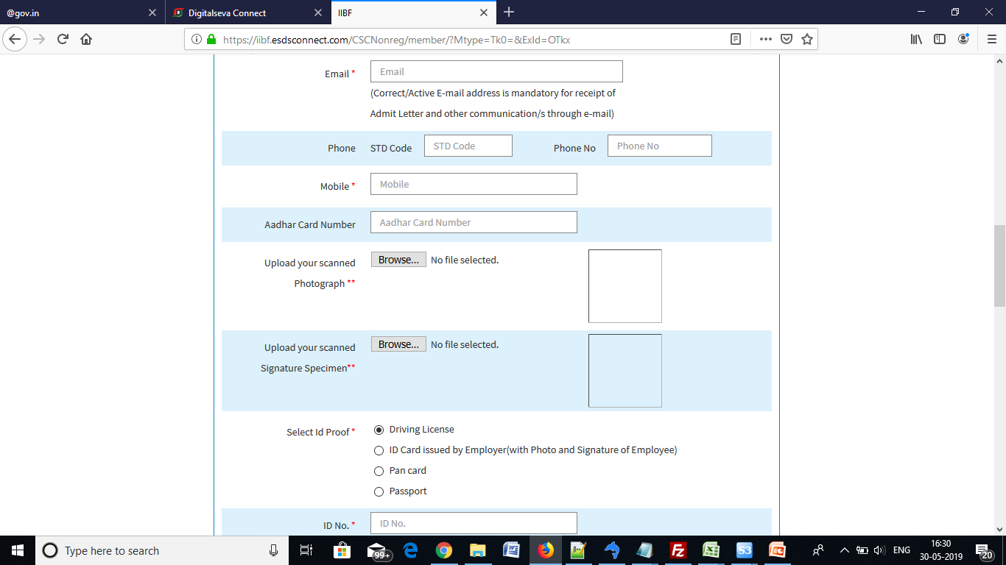
Upload Photo, Signature etc

Slide 9
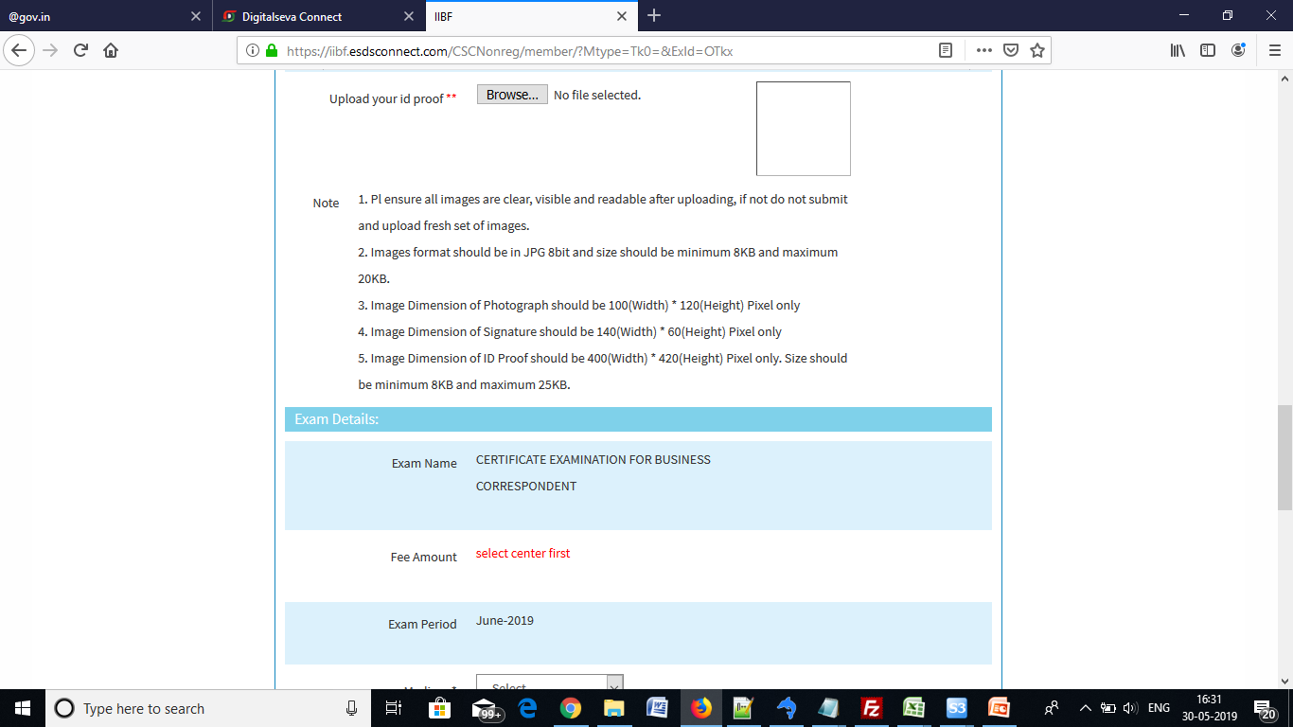
Upload Proof Document

Slide 10
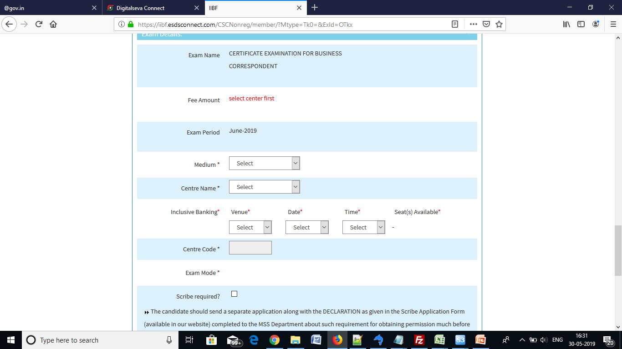
Select exam centre, Venue, date and time

Slide 11
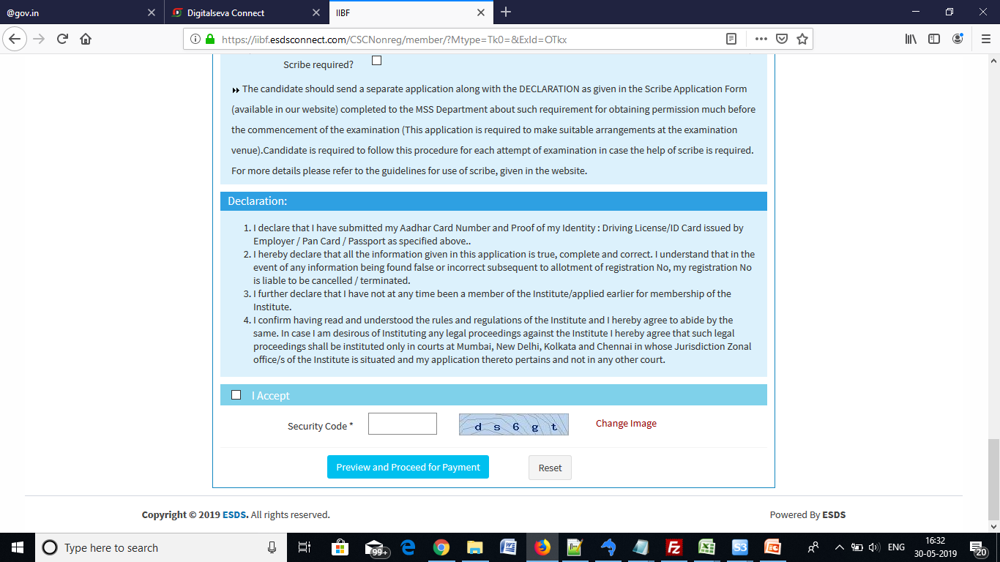
Read instructions and provide security code and proceed for payment

Slide 12
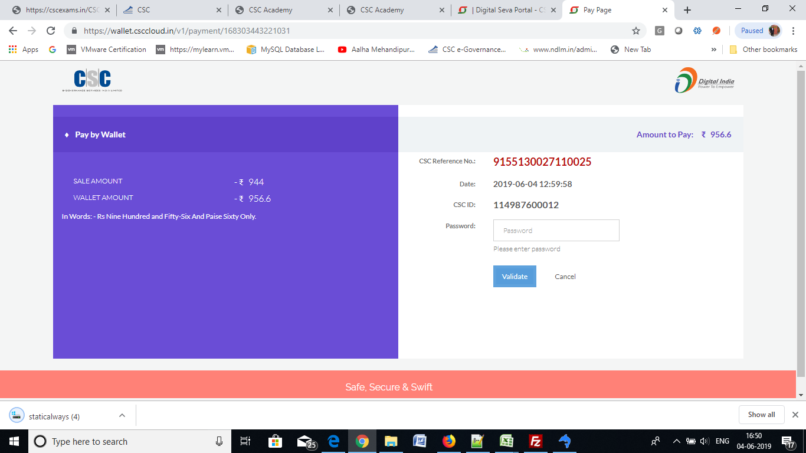
Payment through CSC wallet

