Slide 1


VLE Capacity Building Program

Slide 2
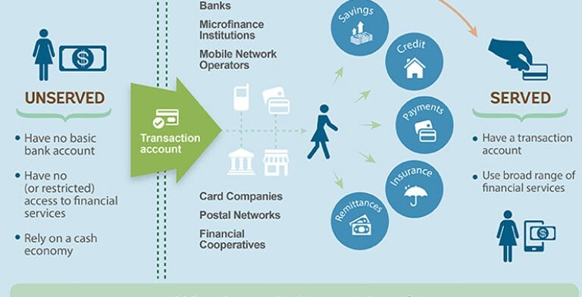

Financial Inclusion
Copyrights © HDFC Bank Confidential | Restricted | Internal | Public*

Slide 3




Financial Inclusion
Products available for all segments
World Class Banking products and services
Helps in building customer Trust
Bank in the village
Transparency
Accessibility and Availability
Customer Focus
Affordability
Copyrights © HDFC Bank Confidential | Restricted | Internal | Public*
Notes:
K3G

Slide 4
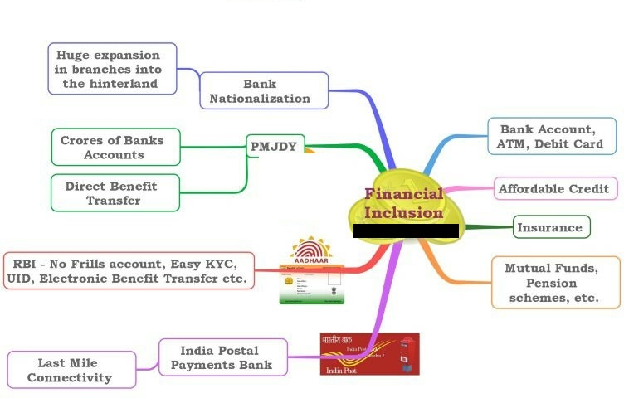
Financial Inclusion
Copyrights © HDFC Bank Confidential | Restricted | Internal | Public*
Notes:
To increase banking penetration and financial inclusion drive, the Reserve Bank of India (RBI) has asked banks to expand their branches in unbanked rural centers and draw up their next Financial Inclusion Plan (FIP) for the period 2013-16.
To facilitate speedier branch expansion in unbanked rural centers for ensuring seamless roll out of the Direct Benefit Transfer/EBT Scheme of the government, banks are advised that they may consider prioritizing the opening of branches in unbanked rural centers
Branch expansion in rural areas is essential to address the existing asymmetries in achieving financial inclusion. The DBT scheme covers benefits like scholarships, pensions, NREGA wages directly to the bank or Post Office accounts of identified beneficiaries.

Slide 5












About HDFC Bank
One stop shop for all financial and payment needs
Core Values
Operational
Excellence
Strong national network
Healthy balance sheet, focus on asset quality
Customer
Focus
Socially and environmentally responsible corporate citizen - Parivartan
Product
Leadership
A digital leader
Sustainability
People
India’s most valued brand
Committed to the highest level of ethical standards, professional integrity,
corporate governance and regulatory compliance
Copyrights © HDFC Bank Confidential | Restricted | Internal | Public*

Slide 6
Business Correspondent Center – Chhota Branch

Slide 7


About Business Correspondent (BC)
One stop shop appointed by the Bank through a Corporate Business Correspondent ( CSC E-Gov) for all financial services
BCs ensure Financial inclusion and increase outreach of Banking services, thereby stronger reach
Business acquisition through BCs provide reach to geographies which were untouched giving granular growth and a Healthy balance sheet
Besides provides Banking services and products, they also promote social schemes floated by the GOI through PMJDY BCs
BC Center
A complete digital mode for transactions and business in line with GOI digital objectives
Copyrights © HDFC Bank Confidential | Restricted | Internal | Public*
03

Slide 8
Roles and Responsibilities of a Business Correspondent
Display all marketing collateral, mandatory posters. Maintain all required registers
Login to Kiosk Banking system (KBS) daily & operate for min 4 hrs a day/ 5 days a week
Market Bank’s products. Generate quality leads and ensure customers transact in the accounts opened
Handle customer
transactions at the BC center. Give a printed receipt to the customer for every txn.
BCs must not charge any commission from customers for providing Banking services
BC Center
fors
BC personally must operate the KBS and should not handed over to a third party
Map the catchment around your centers for business
08
Copyrights © HDFC Bank Confidential | Restricted | Internal | Public*

Slide 9
Business Correspondent – Types of Transactions at the Center
Financial
Non- Financial
Off Us
( Transaction in any Bank Acc)
On Us
( Transaction in an HDFC Bank Acc)
Balance Enquiry
(All Bank Accounts)
Mini Statement
(All Bank Accounts)
Cash Withdrawal
Cash Withdrawal / Deposit
EMI Collections
Funds Transfer
(HDFC Bank-HDFC Bank)
Copyrights © HDFC Bank Confidential | Restricted | Internal | Public*

Slide 10
Basic Banking Principles
Trust- Build customer Trust
Confidentiality – Maintain customer confidentiality
Service – Customer Service is of utmost importance
Knowledge of Socio-economic factors
Copyrights © HDFC Bank Confidential | Restricted | Internal | Public*

Slide 11



Social Security Schemes
The government of India offers a variety of social security schemes including affordable life, accident cover & a guaranteed pension plan
One can invest in them via a HDFC Bank Savings Account
Pradhan Mantri Jeevan Jyoti Bima Yojana (PMJJBY)
Get a life cover of ₹ 2 lacs for a premium of ₹ 330 a year
Subscribe through SMS or NetBanking
Automatically pay your premiums
Pradhan Mantri Suraksha Bima Yojana (PMSBY)
Pay a premium of just ₹12 per year
Get accident insurance cover of up to ₹ 2 lacs
Easily pay via SMS or NetBanking
Atal Pension Yojana
Get guaranteed monthly pension at the age of 60
Monthly investments can be as low as ₹ 42
Choose your pension amount from ₹ 1,000 to ₹ 5,000
Copyrights © HDFC Bank Confidential | Restricted | Internal | Public*

Slide 12
Important Actionables for BC Agents
Copyrights © HDFC Bank Confidential | Restricted | Internal | Public*

Slide 13

Kaam Zimedaaree ka hai !!!
Responsibility
काम ज़िम्मेदारी का है
Copyrights © HDFC Bank Confidential | Restricted | Internal | Public*

Slide 14

Working Hours
BC Banking Outlets – Working Hours
Minimum of 04 HOURS PER DAY for at least 05 DAYS A WEEK.
Copyrights © HDFC Bank Confidential | Restricted | Internal | Public*
Copyrights © HDFC Bank Confidential | Restricted | Internal | Public*

Slide 15

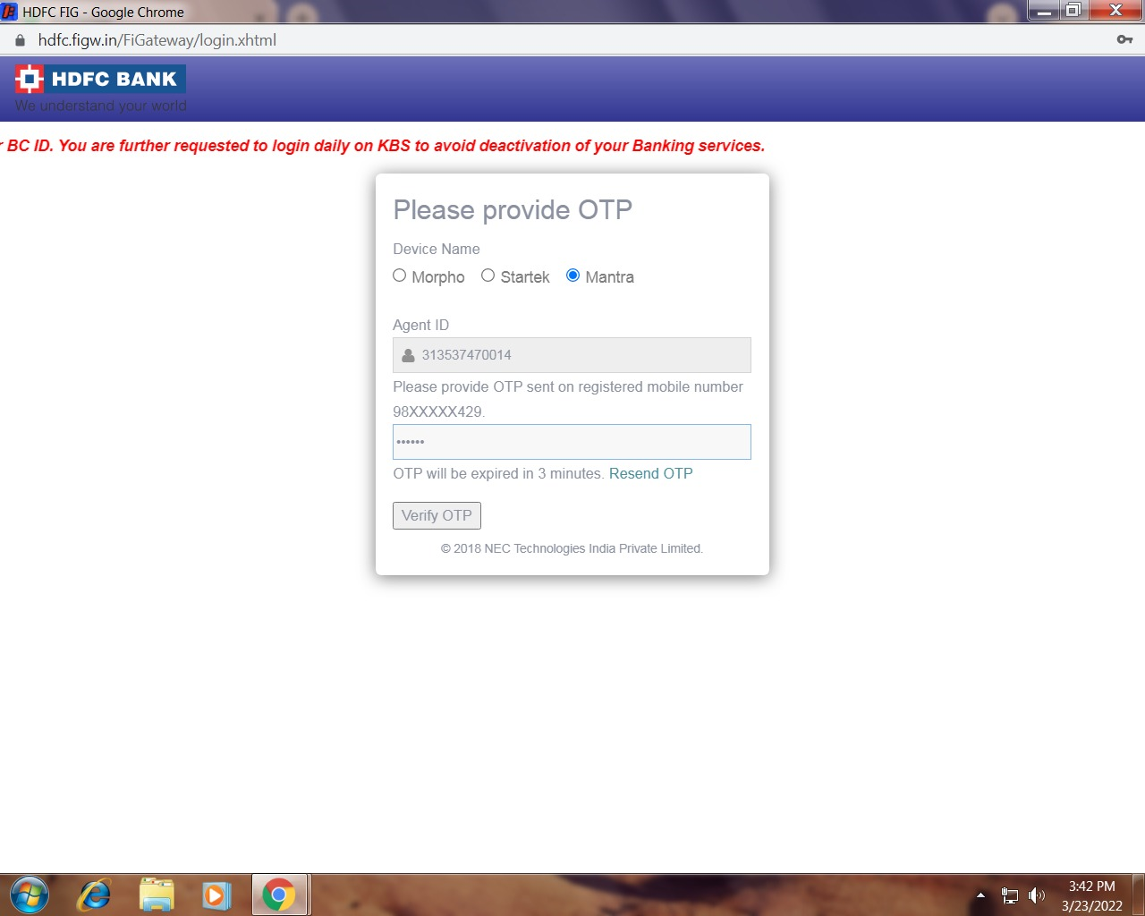
“HAR DIN LOGIN HAI JARURI”
Login
Login Daily on Kiosk Banking System (KBS)
Login Process –
URL - https://hdfc.figw.in/FiGateway
Enter 12-digit VLE code
6-digit OTP is received
Enter OTP correctly and click the verify OTP option.
Input 12 Digit Aadhaar Number.
Finger authentication through Biometric.
Post authentication successful login in KBS System.
Logout
Copyrights © HDFC Bank Confidential | Restricted | Internal | Public*

Slide 16


IIBF and Police Verification certificate
IIBF Certification Mandatory by RBI
Audit Requirement – Police Verification
Copyrights © HDFC Bank Confidential | Restricted | Internal | Public*

Slide 17


Customer Service
ü
1
HDFC Bank – BC Agent CANNOT be another bank BC Agent
Other Bank BC
2
NO SERVICES CHARGES to be collected from Customers for Banking Products
3
Maintain Customer confidentiality
Copyrights © HDFC Bank Confidential | Restricted | Internal | Public*

Slide 18
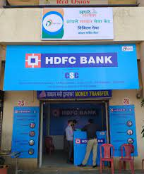
Mandatory Displays at BC Center
Display all
Marketing Collateral given by the Bank
Mandatory Posters given by the Bank
Mandatory registers as per format shared by the Bank
Copyrights © HDFC Bank Confidential | Restricted | Internal | Public*

Slide 19
Registers format shared by the Bank
COMPLAINT REGSITER
TRANSACTION REGISTER
VISIT REGISTER
Copyrights © HDFC Bank Confidential | Restricted | Internal | Public*

Slide 20
Registers format shared by the Bank
ACCOUNT OPENING REGISTER
FIXED / RECURRING DEPOSIT REGISTER
Copyrights © HDFC Bank Confidential | Restricted | Internal | Public*

Slide 21

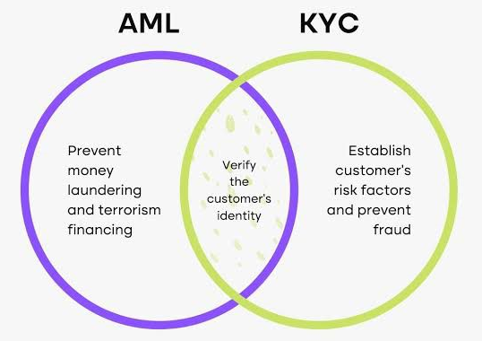
Know Your Customer & Anti Money Laundering
Copyrights © HDFC Bank Confidential | Restricted | Internal | Public*

Slide 22





Anti Money Laundering (AML) – 3 Stages
LAYERING
Money Launder with the HELP of others ( X / Y / Z)
forms COMPLEX chain of Transaction
PLACEMENT
Money Launder Use Bank Account to Place the Dirty Money
Placement in Account - Cash Deposition / RTGS - NEFT
from his other account
Transfer to Account of X
Transfer to Account of Z
Transfer to Account of Y
INTEGRATION
The Money is Transferred to account of
Person / Entity
Which is further used for purchasing of
Property / Luxury items.
It Become difficult to Trace the source of Transaction
Copyrights © HDFC Bank Confidential | Restricted | Internal | Public*

Slide 23
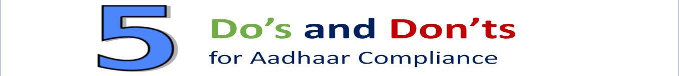
Aadhaar Compliance
Important precautions to be taken while handling customer’s Aadhaar.
Do’s
Don’ts
1
Accept Aadhaar only when given voluntarily by the customer post offering alternatives*
1
Never share Aadhaar information of the customer with any third parties or via e-mail, phone etc.
2
Inform the customer of the purpose of taking Aadhaar, in local language understandable to the customer
2
Never store Aadhaar copies in branch, laptops / desktops, mobile phones or any portable storage device.
Inform & collect customer’s consent prior to voluntary submission of Aadhaar.
Never request customer to give Aadhaar through email or unsecured social media platforms like WhatsApp, Facebook, etc.
3
3
4
Aadhaar should be used only for the purpose informed to the customer
4
Never obtain additional Aadhaar copies from customers.
5
Always ensure privacy of customer’s Aadhaar Data.
5
Never publish, display, transfer or post publicly Aadhaar details of the customer.
* Note: KYC Alternatives as per prevalent guidelines should be offered to the customers.
Each and every Agent / Bank staff / Business Correspondent (BC) / Business Facilitator (BF) is responsible for ensuring Aadhaar compliance – any non-compliance can lead to strict action / penalties.
Copyrights © HDFC Bank Confidential | Restricted | Internal | Public*

Slide 24
Important instructions on Transactions
Split/Multiple Transactions
Multiple Transaction
Transactions which are performed due to system limitation
E.g.: Cash withdrawal of Rs 50,000 broken into more than one transaction ( 5 Transactions of Rs 10,000 each) since the system allows to withdraw Rs 10,000 per transaction
Split Transactions
Transactions which are split into smaller amounts intentionally/unintentionally without any system limitation
E.g.: Cash withdrawal of Rs 10,000 split into more than one transaction even though the system allows to withdraw as a single transaction
Important Guidance
BC Agents must not encourage and carry out multiple and split transactions at their center

Slide 25
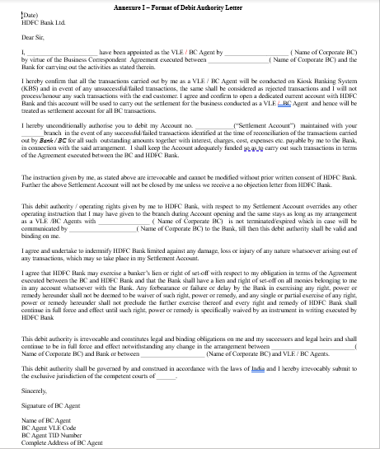
Actionable for Business Correspondents – Debit Authority Letter
A One Time Debit Authority Letter from BC Agents is required for a failed / reversed customer transaction.
BC Agent must visit the nearest branch with a hard copy of the Debit Authority Letter cum Declaration.
BC Agent must fill up the required details and submit duly signed request along with self- signed copy of valid photo identification proof
SAMPLE

Slide 26
TDS Waiver for customer cash transactions for BC Agents
Tax Deduction at Source (TDS) Rule:-
Effective September 1, 2019, as per Section 194N of the Income-tax Act, 1961, banks are required to deduct TDS on Cash Withdrawal. Further amended w.e.f 1st July’20.
BC Agents cash transactions carried out for customer cash withdrawal / deposit are exempted from TDS
As per the IT Act, BC Agents are eligible to get waiver on TDS for cash withdrawal only for BC related transactions
Process of Availing TDS Waiver
BC Agent must submit the TDS waiver declaration along with a self signed copy of the BC Agent certificate at the beginning of every Financial year at the HDFC Bank branch.

Slide 27
Thank you

