Slide 1
Process Flow and How to download
Kutuki

Slide 2
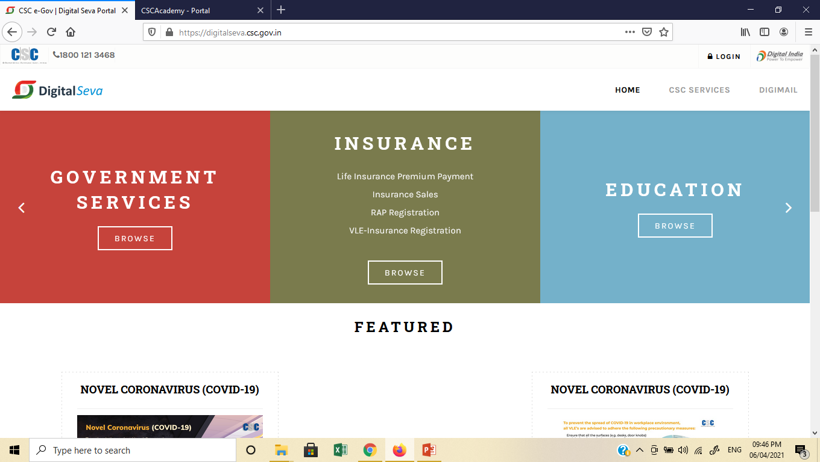
1
Login

Slide 3
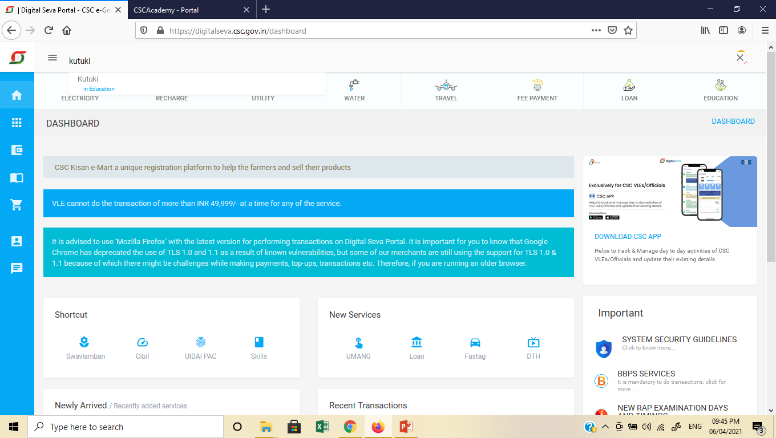
Search Kutuki
2

Slide 4
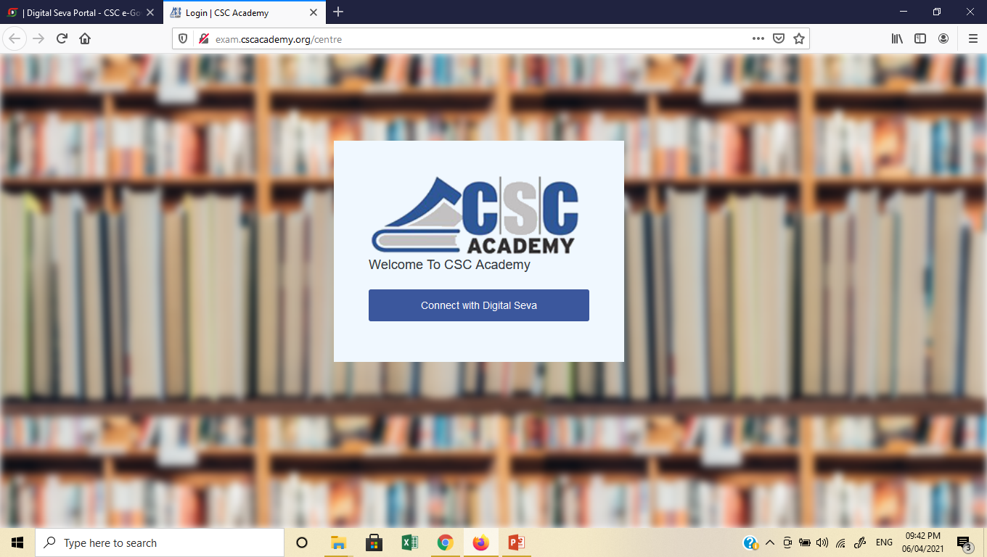
Connect with digital Sewa
3

Slide 5
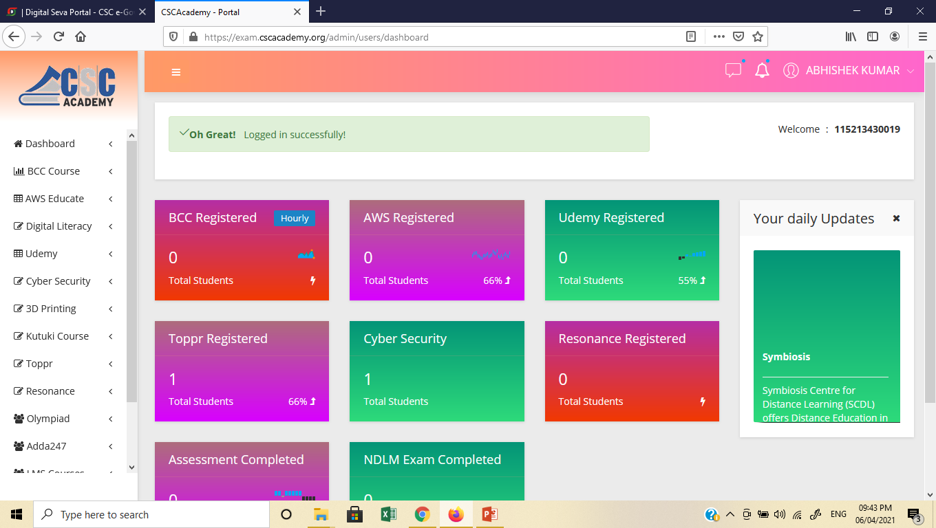
4
Click ‘Kutuki Course’

Slide 6
Click on Add/View
5

Slide 7
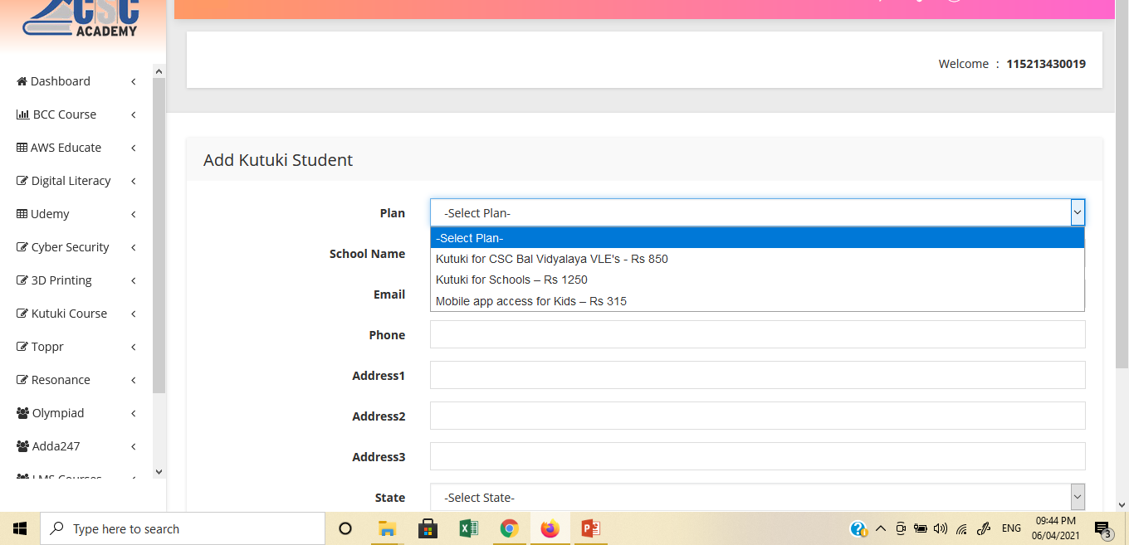
Select Plan and fill the required details.
6
Submit

Slide 8
You will be redirected to Payment Gateway and payment for the selected service will be deducted from your CSC Wallet.
The entire amount of Rs 315 or 1250 will be deducted from your wallet.
The VLEs’ share is credited every fortnight in their wallet.
No ID and password is sent on user’s mobile or email ID.
Just download the Kutuki App by using mobile number of the parent and received OTP. Now, let the child enjoy the content.

Slide 9
How to download the Kutuki App?
Direct Link to Download the App - https://kutuki.info/csc
(This is a common link for both iOS (Apple) and Android Phones)
OR
It can be downloaded from Google Play Store

Slide 12
Happy Selling!
Thanks!

