Slide 1
Overview of Service
CSC Academy and Symbiosis joined hands to make CSCs as Symbiosis Distance Learning facilitation centre. Under this partnership, Symbiosis offer various educational, vocational, skill programs and introduce new initiatives through the CSC network across the Country.
“Version date:27 March 2020"

Slide 2
Objectives
To provide education and training opportunities beyond the boundaries of a classroom, so as to transform the way people learn.
To provide learners with flexible learning opportunities anywhere, anytime.
To provide the professional courses with affordable fee to citizens.

Slide 3
Features
e-learning
Daily online lectures by Expert Faculty
Regular Online Faculty Chat
Online Assignments & On Demand Exam
Exams across 365 days
Exams at convenient time & location

Slide 4
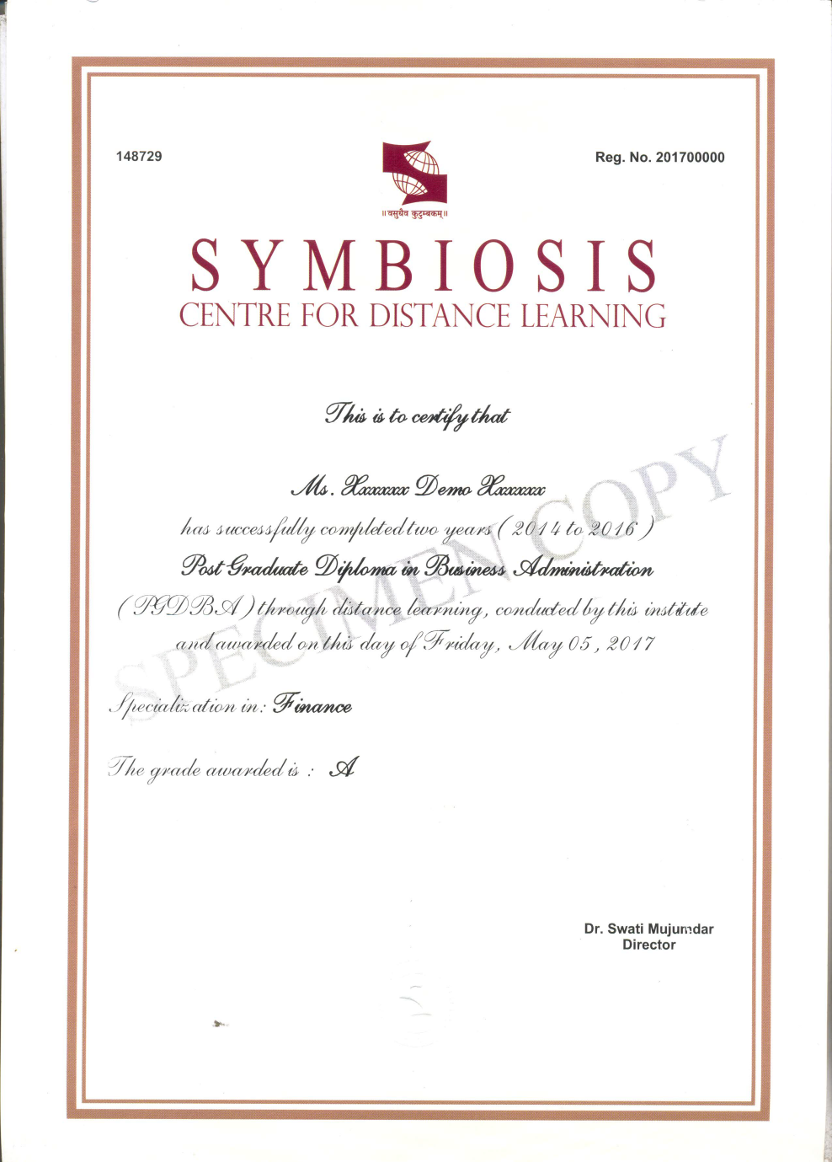
Sample certificate for Autonomous courses

