Slide 1
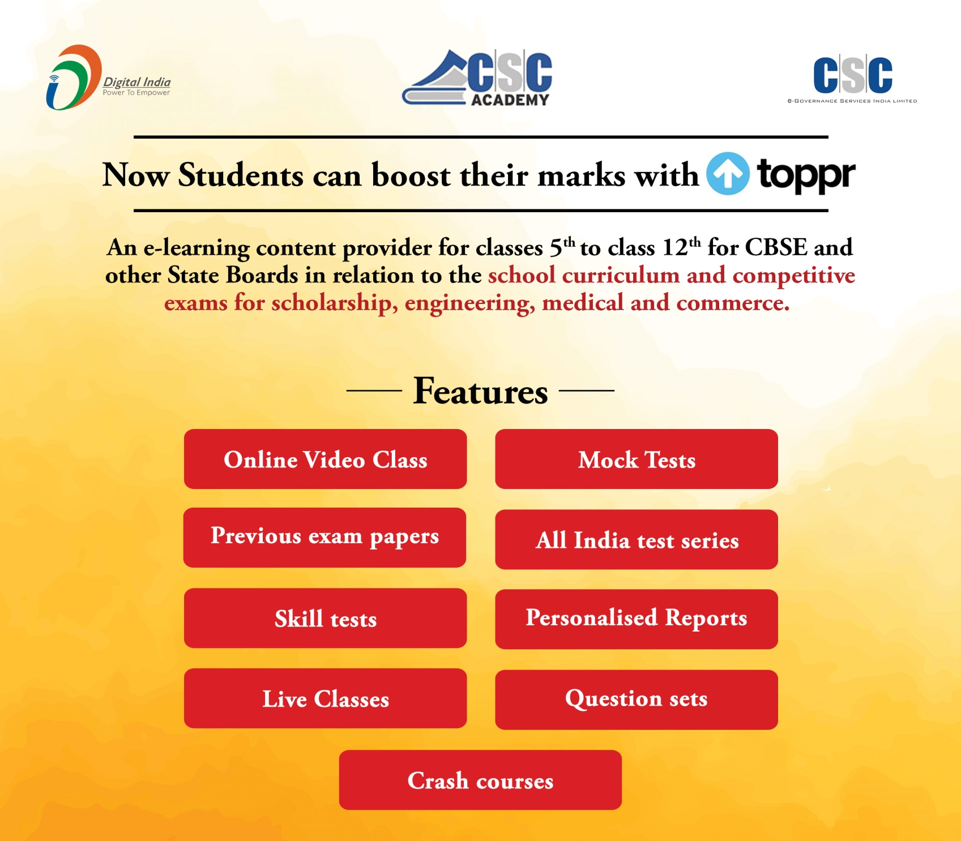
Version date:24 March 2020
Toppr – Service Details

Slide 2
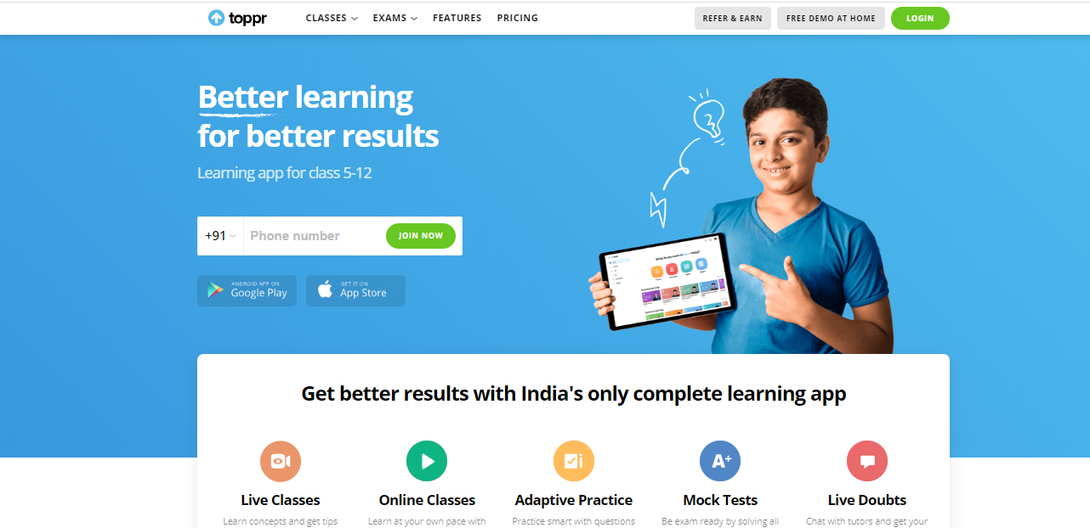
Login to the Toppr
To access the service, type the URL in browser https://www.toppr.com/

Slide 3
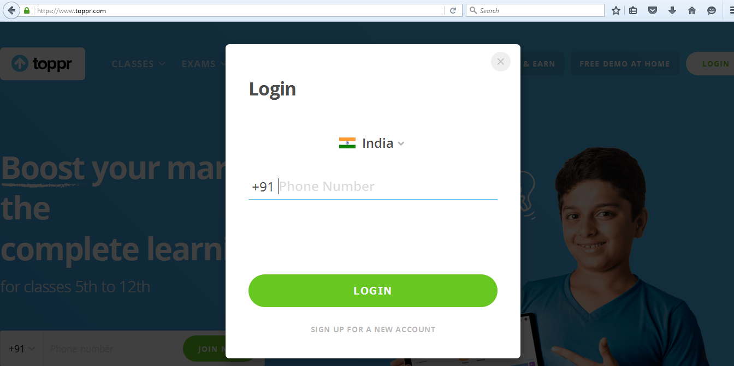
After clicking on LOGIN enter a registered phone number and click on login Button.
(First time login with OTP)
2) Enter registered mobile number
77123456789

Slide 4
Select Class
1) Select the same class as selected in registration form and Click on next to proceed

Slide 5
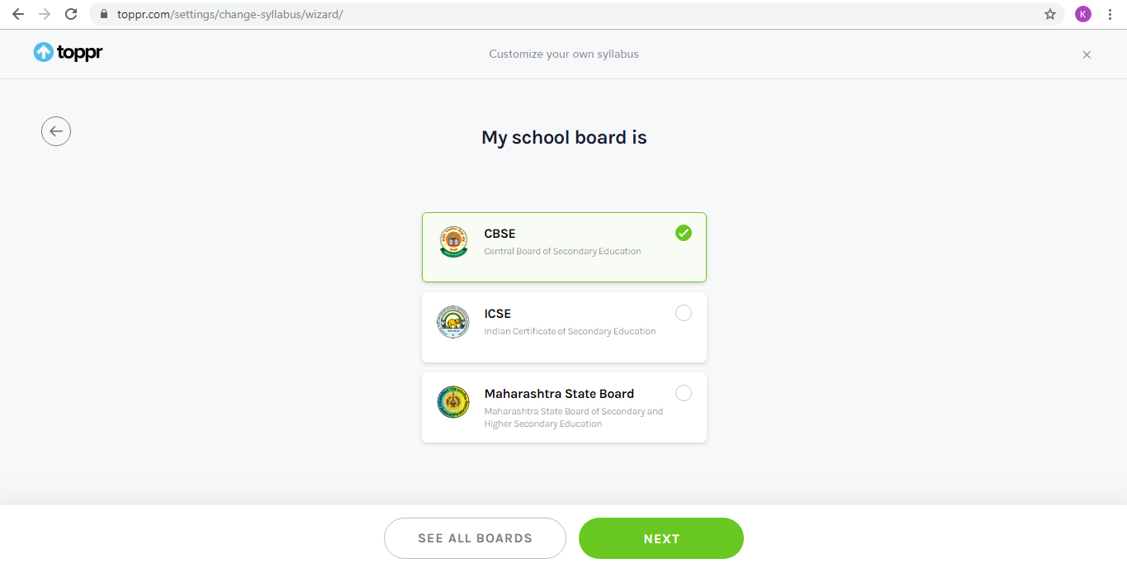
Select School Board
2) Select the school board or click on see all boards if board is not in the list

Slide 6
Select the competitive exam
Select the competitive exams for which you are preparing and click on next

Slide 7
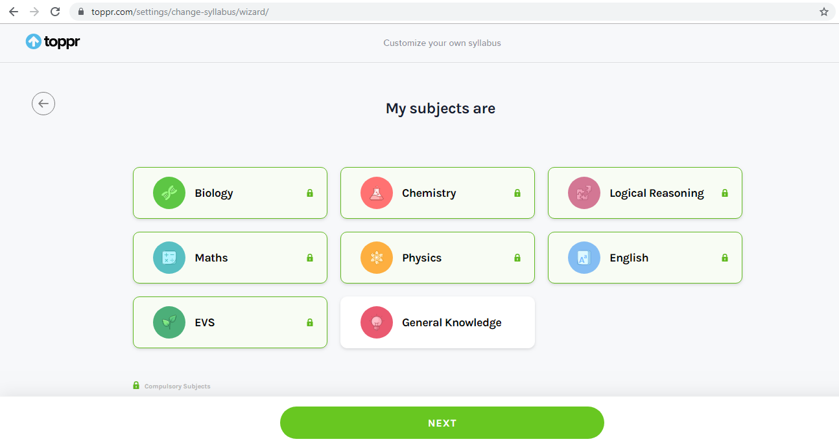
Selection of optional subjects (Subjects with icon are compulsory subjects)
Below screen will come and select the other optional subjects and click on next.
icon represents compulsory subjects

Slide 8
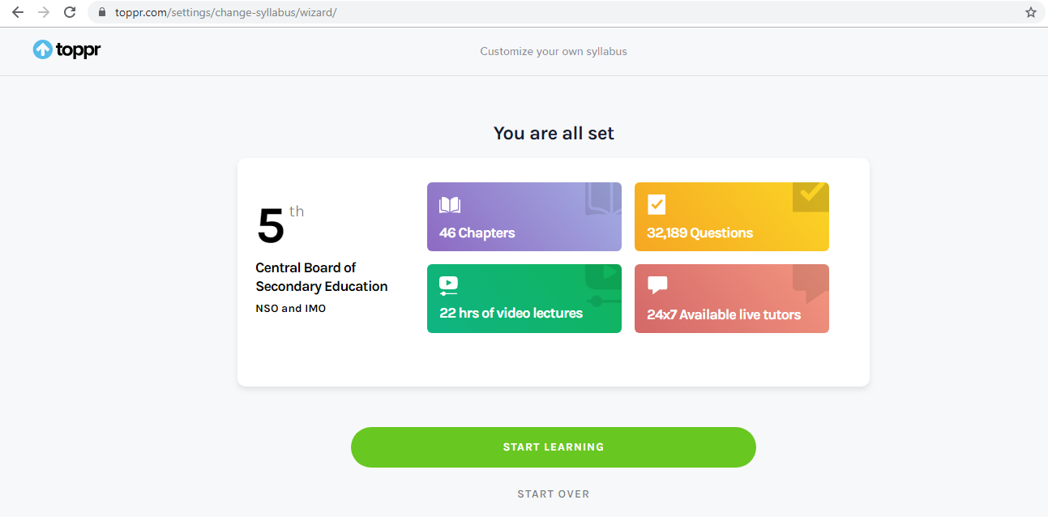
Syllabus is set with all selections
Click on start learning to proceed further

Slide 9
Set the Password

Slide 10
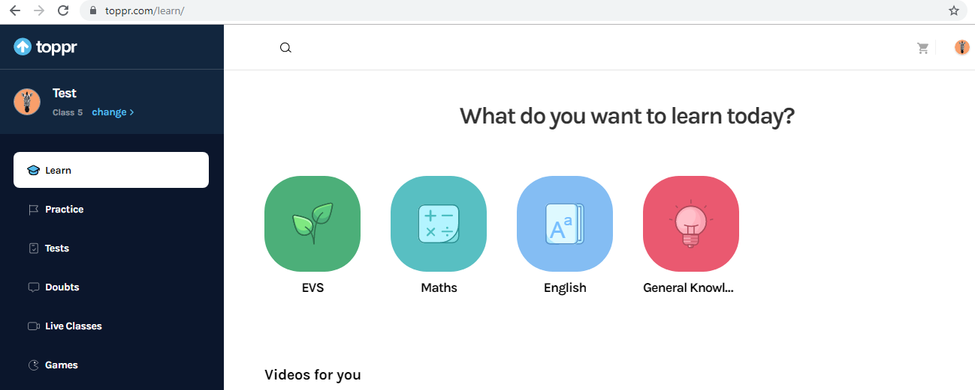
How to login 2nd time - Set the Password and Login via password instead of OTP
You can Set the password for Toppr.com and no OTP is required for next login
1) Click on icon at the top right corner

Slide 11
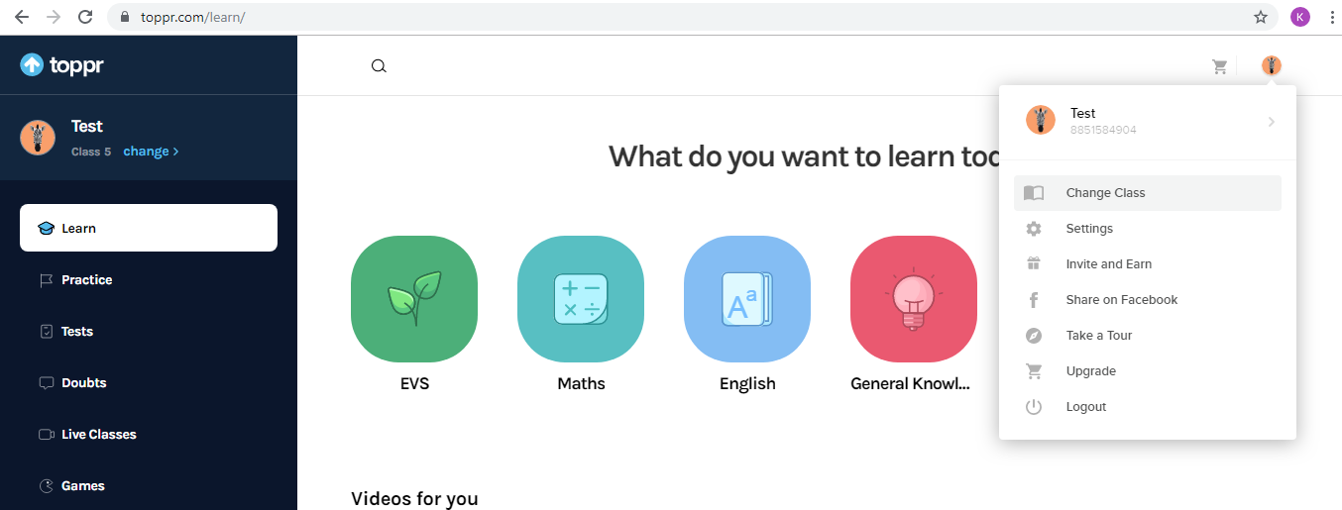
2) Click on settings

Slide 12
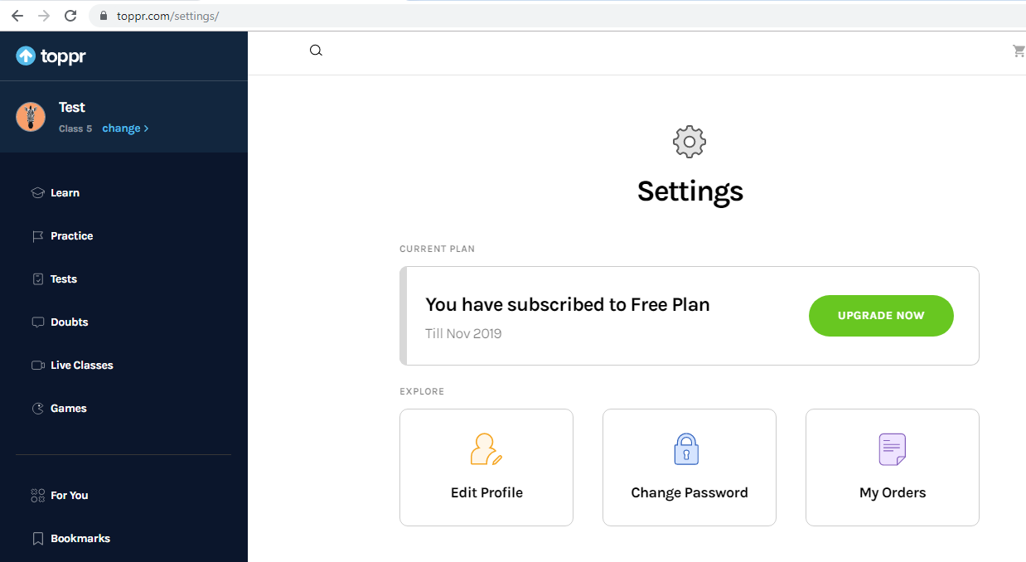
3) Click Change Password

Slide 13
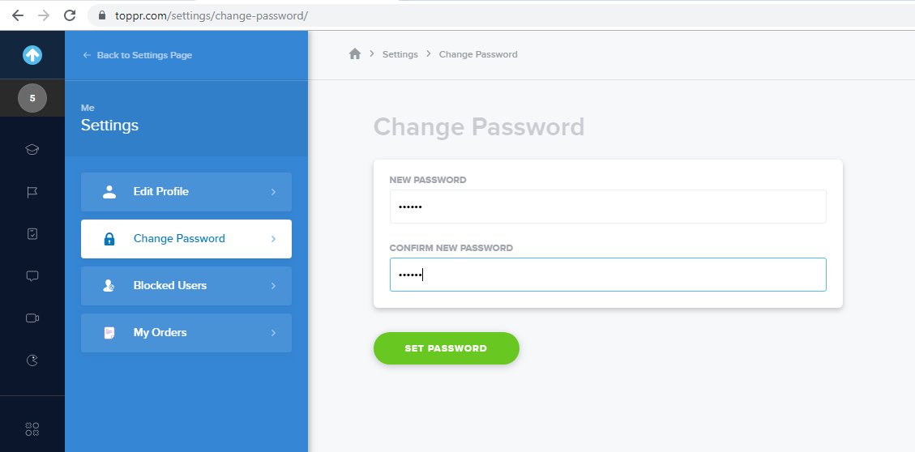
4) Enter Password Details and click on set password

Slide 15
Toppr Features

Slide 16
Toppr Features
Following are the Toppr Features
Online Classes – Video Lectures, Concepts and Stories
Test and Competitive Exam preparation
Personalized Reports

Slide 17
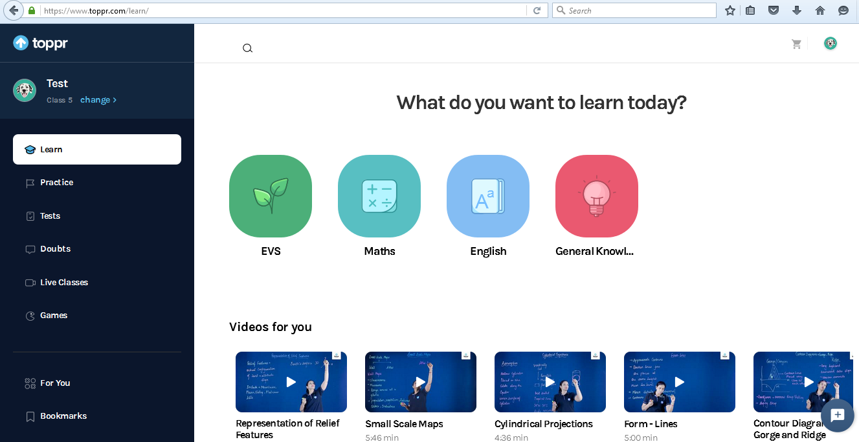
Video lectures
After login, below screen will appear
1) Click on any of the subject which you want to study
c

Slide 18
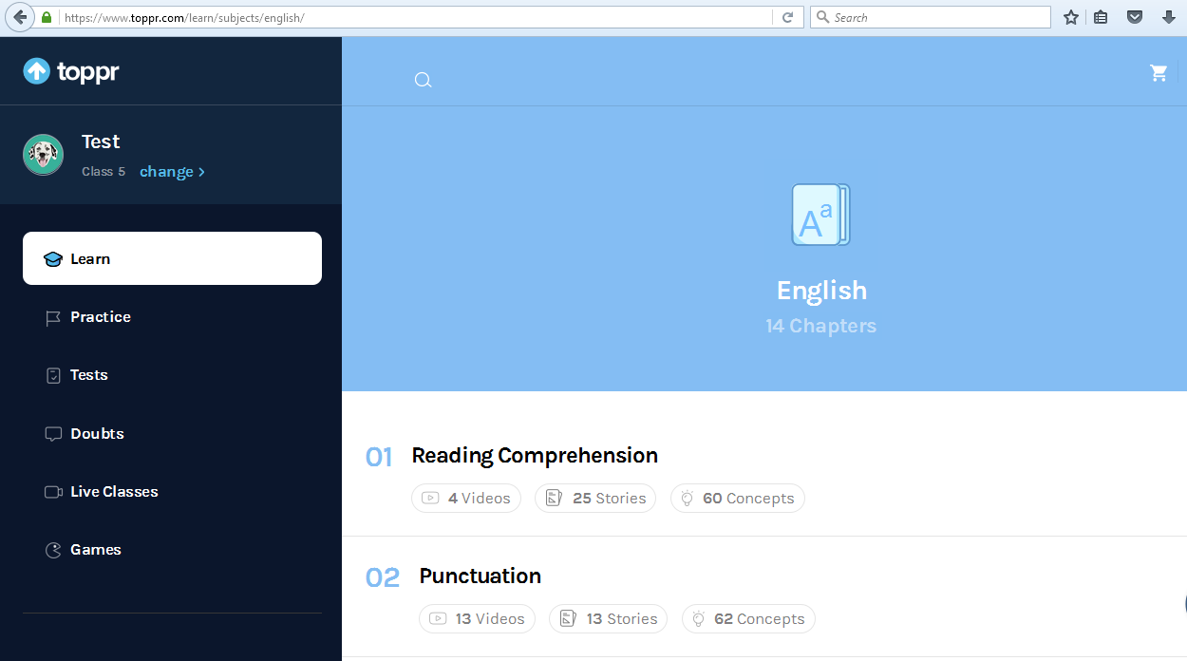
After clicking on any of the subject, a new window will open with complete list of chapters
1)Click to view videos related to chapter

Slide 19
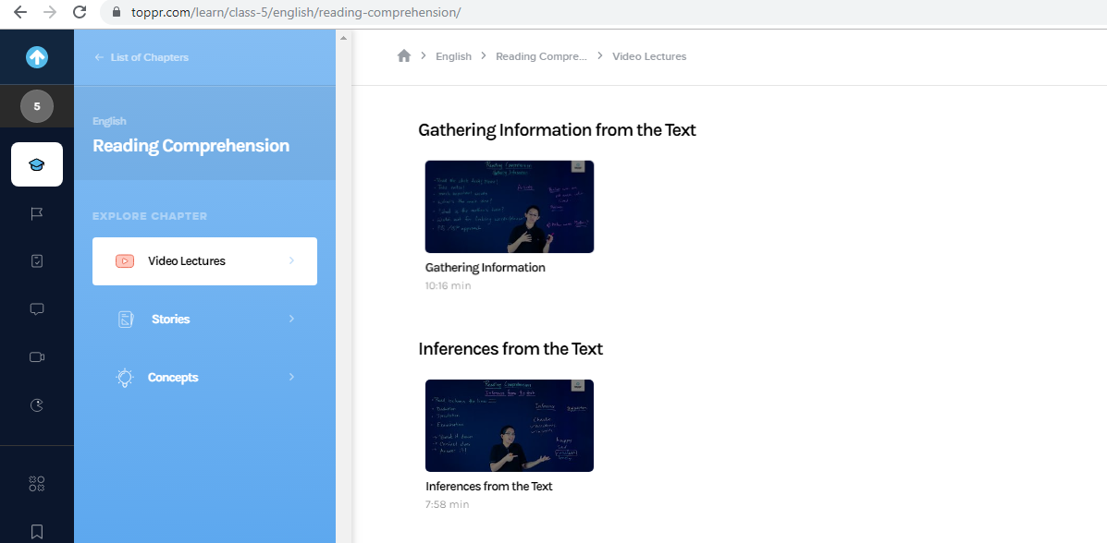
Click here to go to the menu list
2)List of videos will come related to selected chapter

Slide 20
3) Double click on video to view on full screen

Slide 21
How to change language in Video Lectures
Click on language & Select any one of them

Slide 22
How to change speed of the video lectures (Slow or fast speed)
Speed can be increased/decreased by clicking on these options

Slide 23
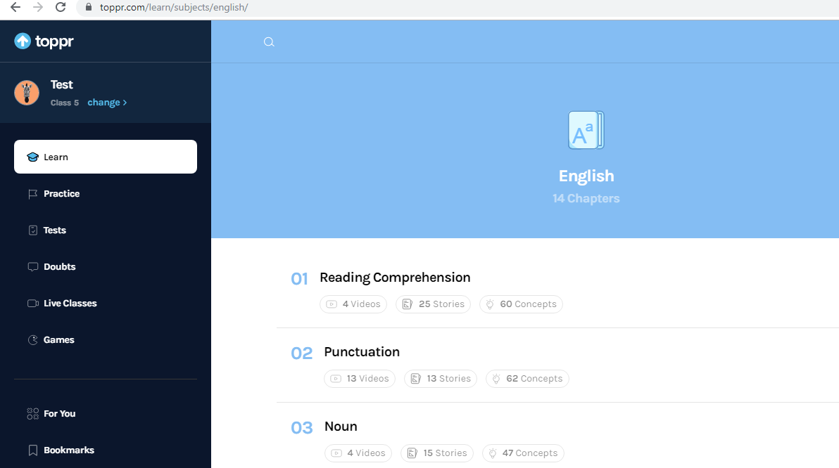
How to View Stories
Click to view videos related to chapter
1) Click to view Stories related to chapter

Slide 24
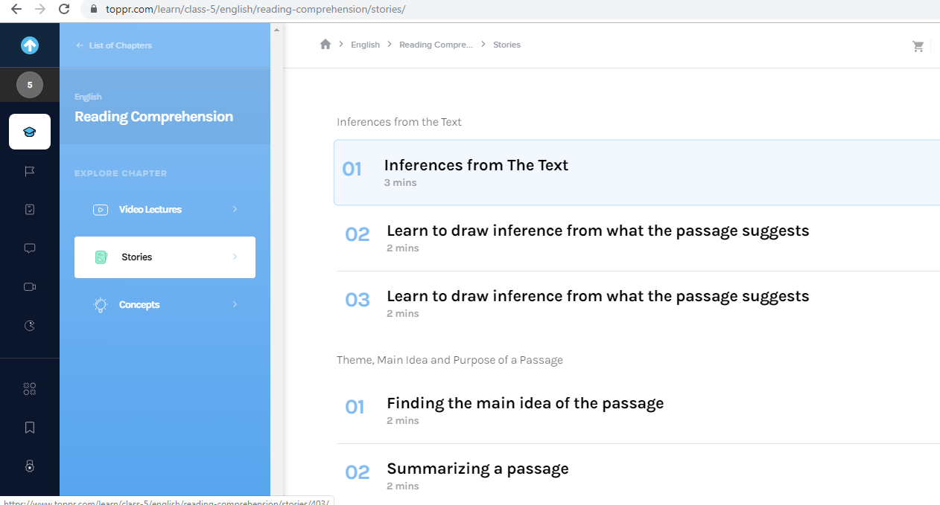
2)List of stories will come related to selected chapter

Slide 25
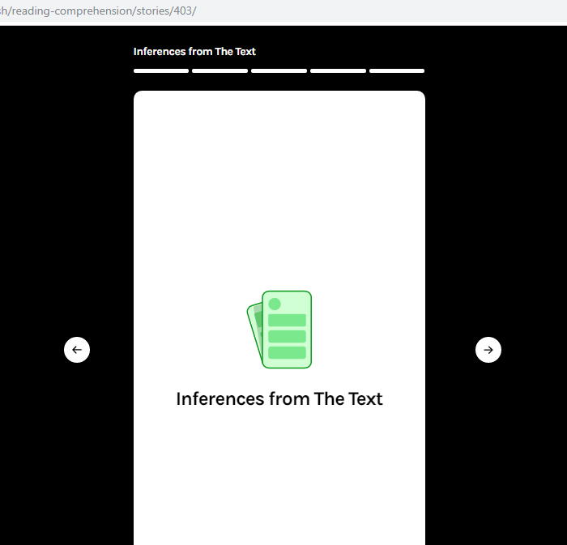
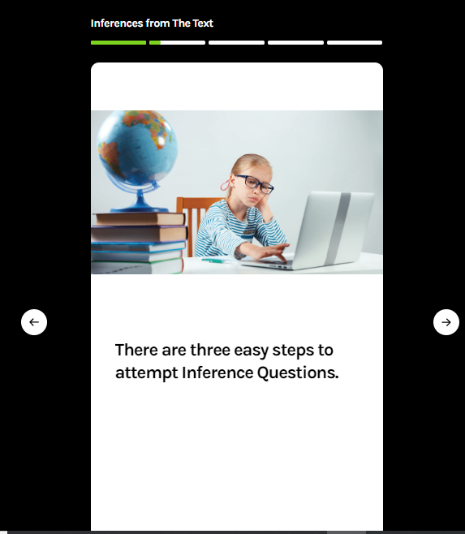
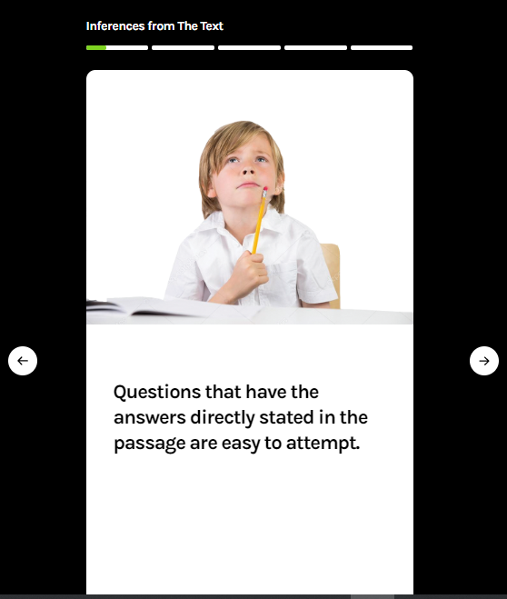
3)Double click on list of stories and swipe towards right or left

Slide 26
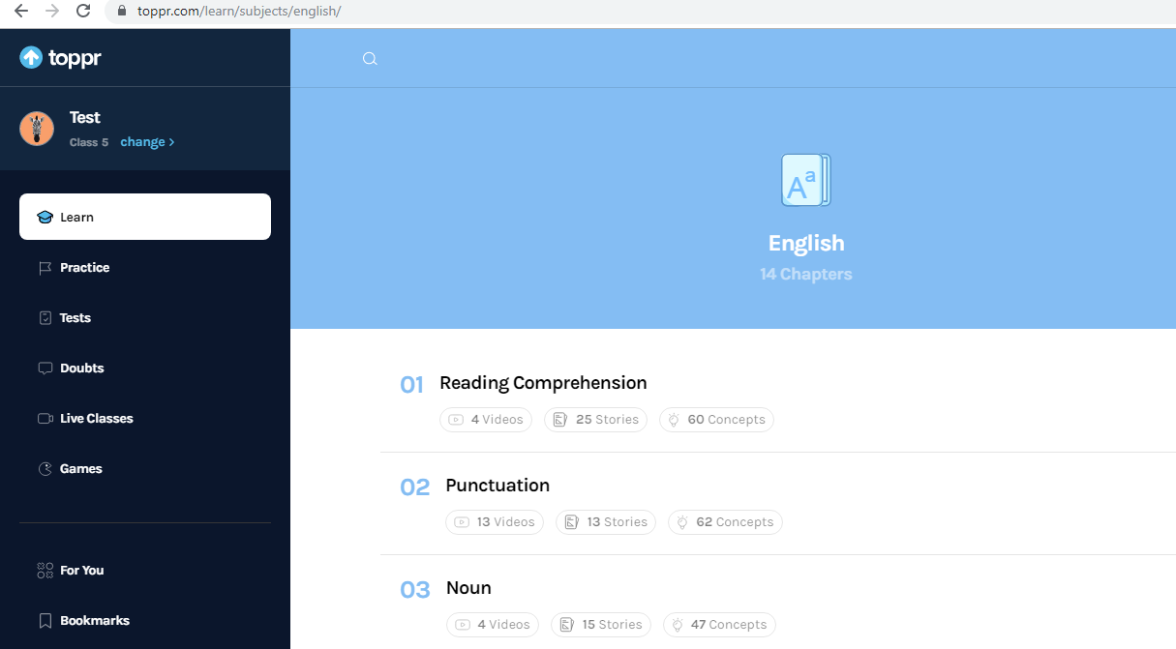
How to view Concepts
1) Click to view concepts related to chapter

Slide 27
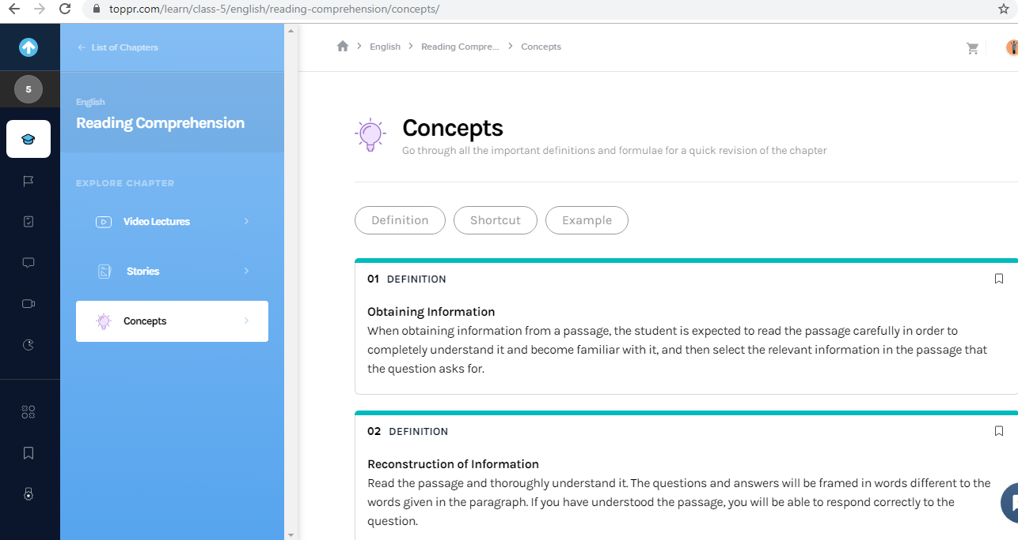
All concept will come after clicking on concepts

Slide 28
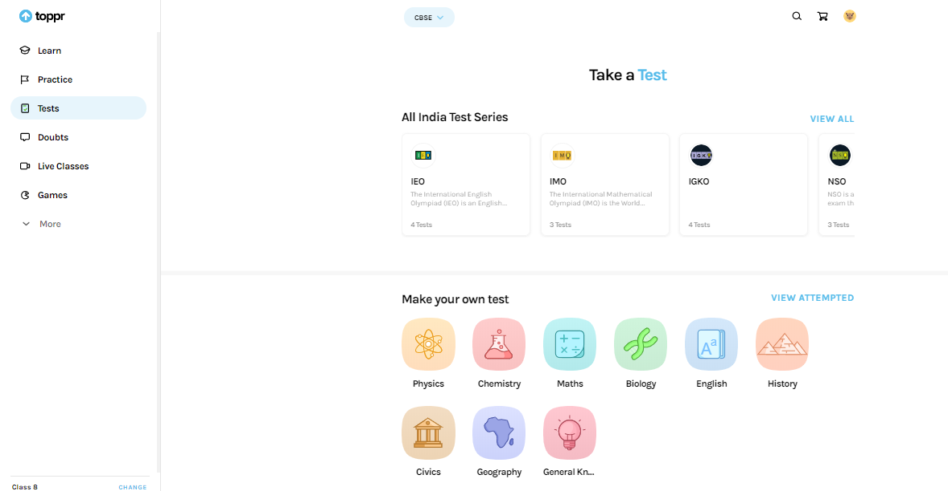
Test And Competitive Exam Preparation
2) Attempt All India Test Series
1) Click on Tests to practice Test Series/Previous Papers or to create your own test.
3) Or Create your own test

Slide 29
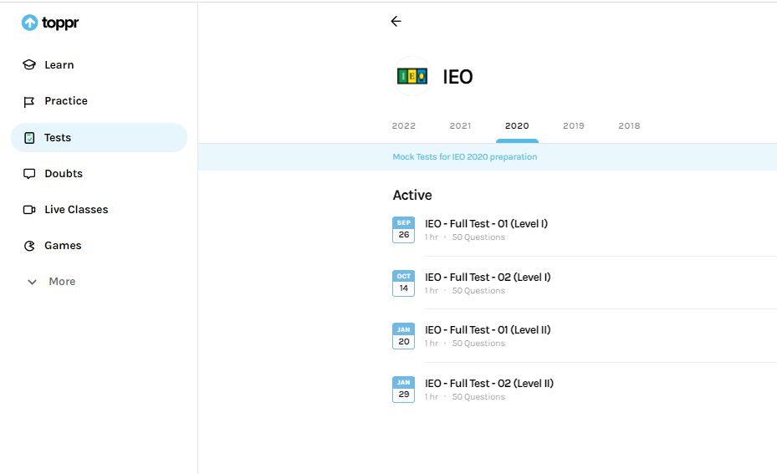
All India Test Series
Previous Years Exams
Select the exam for which test is to be taken

Slide 30
Create your own tests
Select the subject for which test is to created

Slide 31
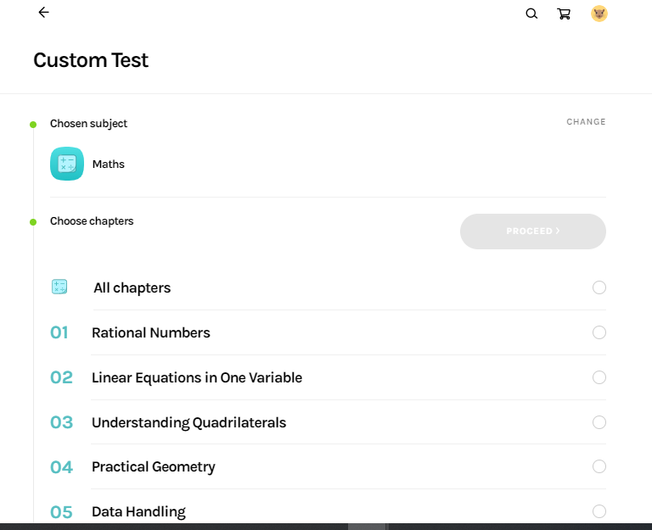
Select the chapter
Select the Chapters

Slide 32
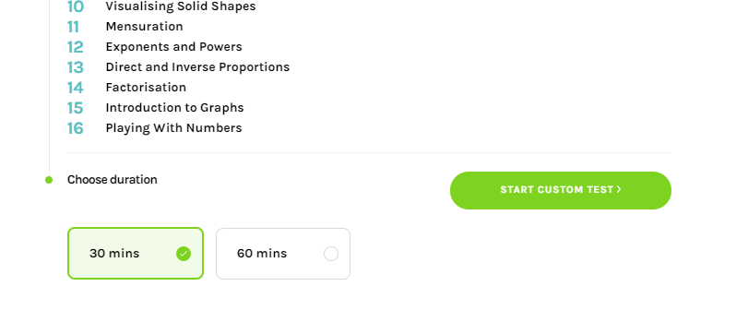
Select the Time Duration and start the test

Slide 33
To stop the test
Test Status

Slide 34
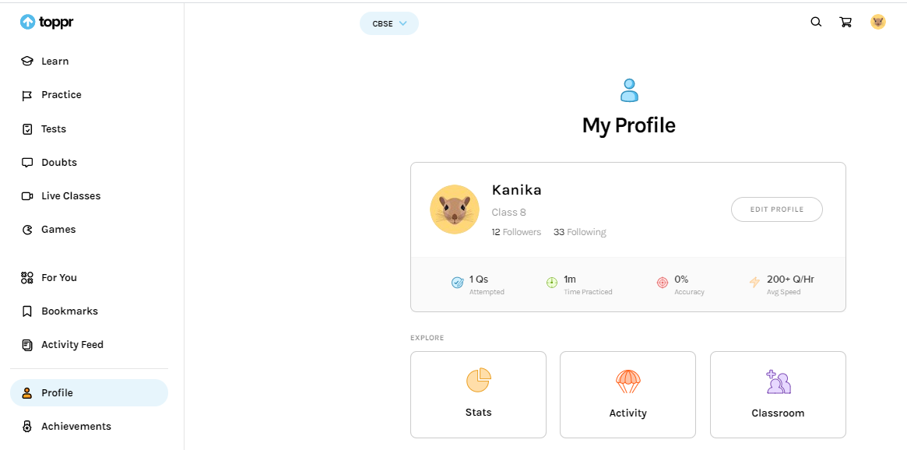
Personalized Reports
Report Status can be checked in profile

Slide 35
Thank you!

