Slide 1
Version date:24 March 2020
How to Purchase Toppr for Customer

Slide 2
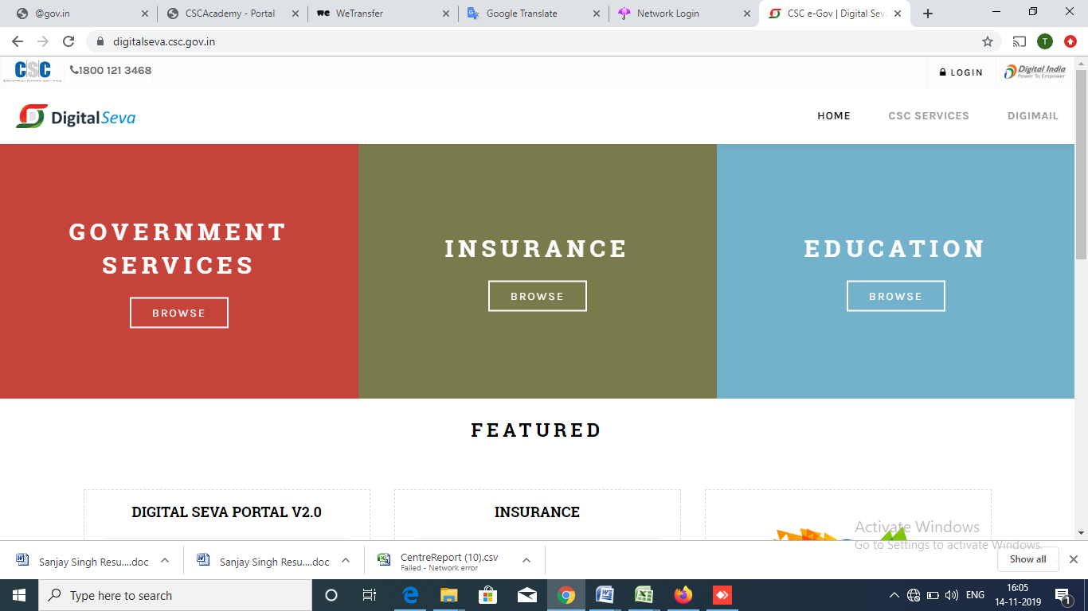
How to Subscribe New Candidate for Toppr Service
1) Login to Digital Seva Portal

Slide 3
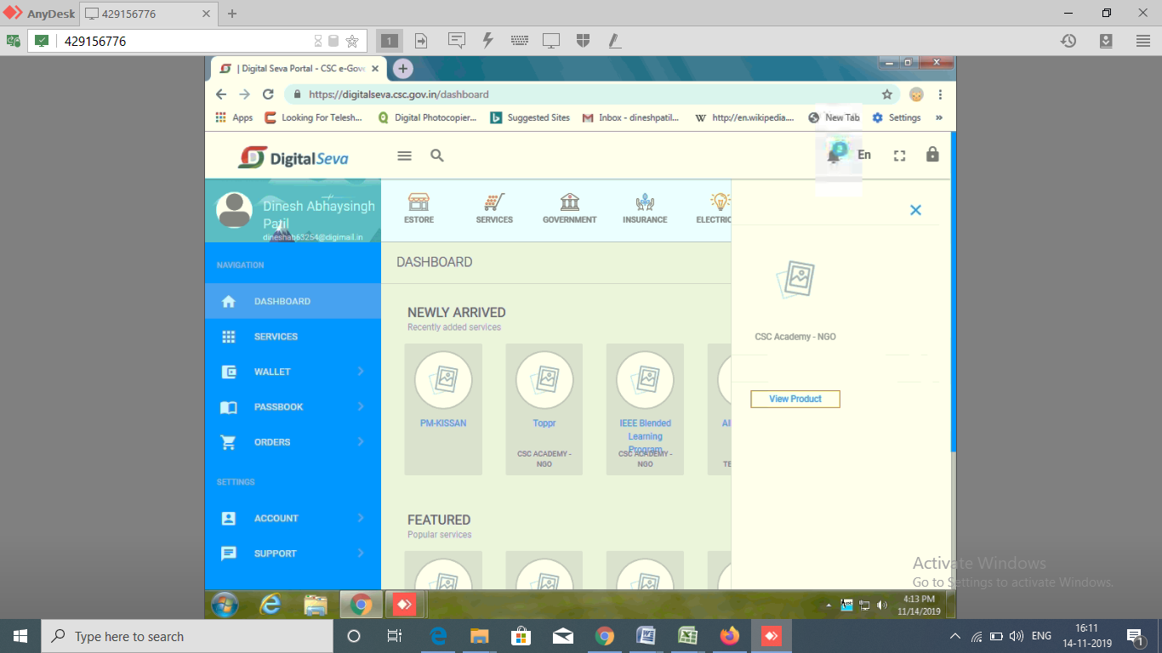
2) Search for Toppr
3) Click on View Product

Slide 4
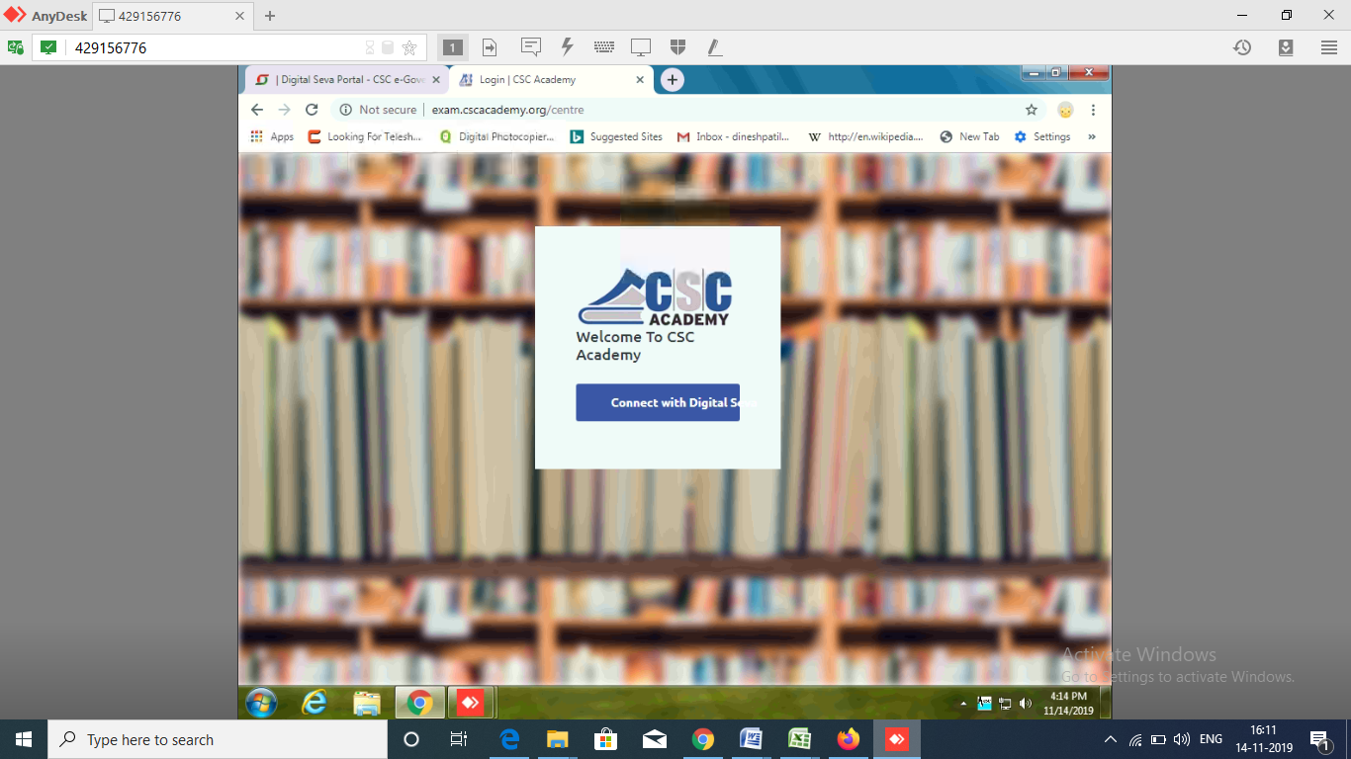
Website will redirect to exam.cscacademy.org/centre

Slide 5
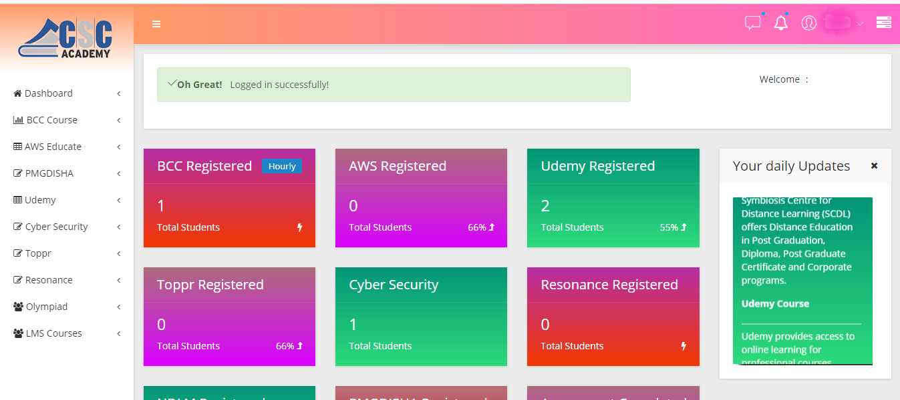
Below Window will appear

Slide 6
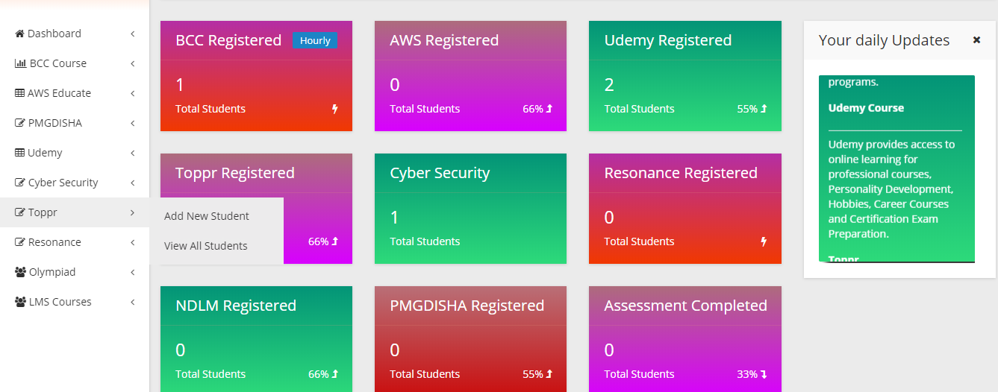
Steps to Register New Candidate/View all registered students
Click Toppr and Add new Student or view list of all Students

Slide 7
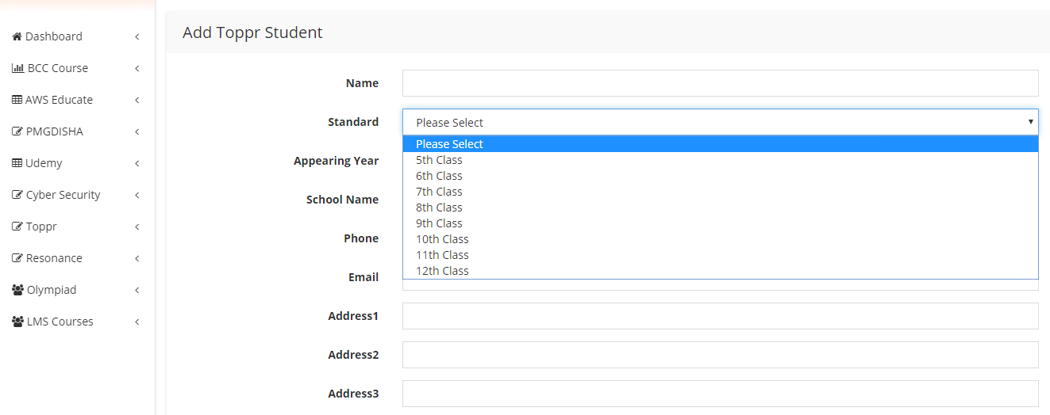
Add all the required details of the candidate
Add all details and Select class & Appearing year from Dropdown

Slide 8
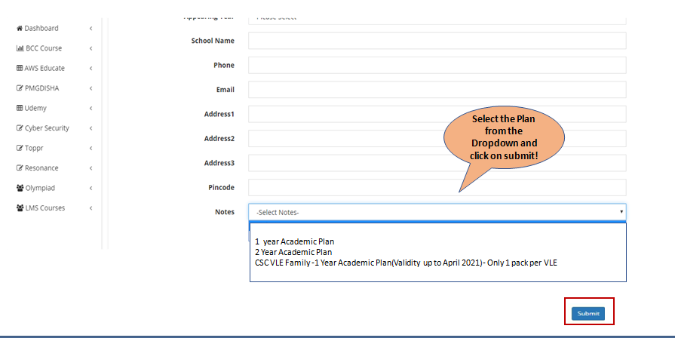

Slide 9
Payment completion
Once submit button is clicked site will redirect to payment gateway, where payment will be done from CSC Wallet.

Slide 10
How to Activate Toppr account after purchase

Slide 11
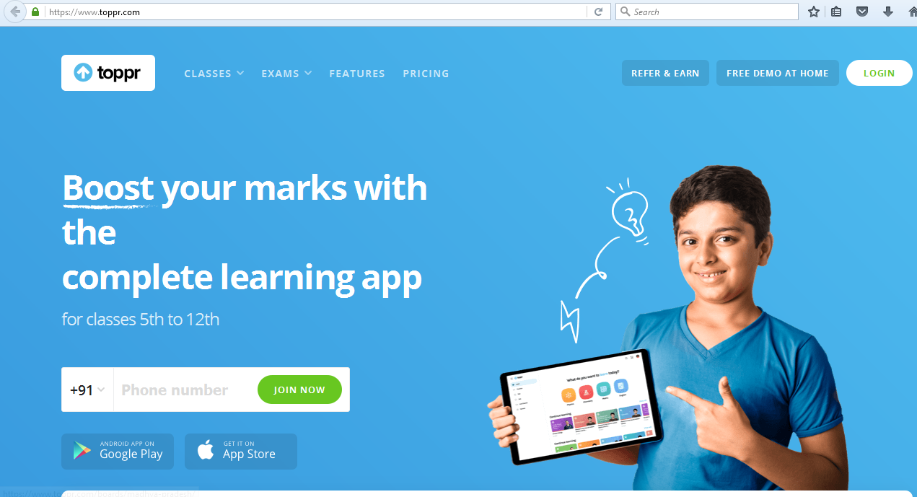
Once the payment is successful, candidate can start accessing TOPPR services
To access the services, type the URL in browser https://www.toppr.com/
No other notification will be send separately after registration to email id/mobile number.
Start login with registered mobile number only.

Slide 12
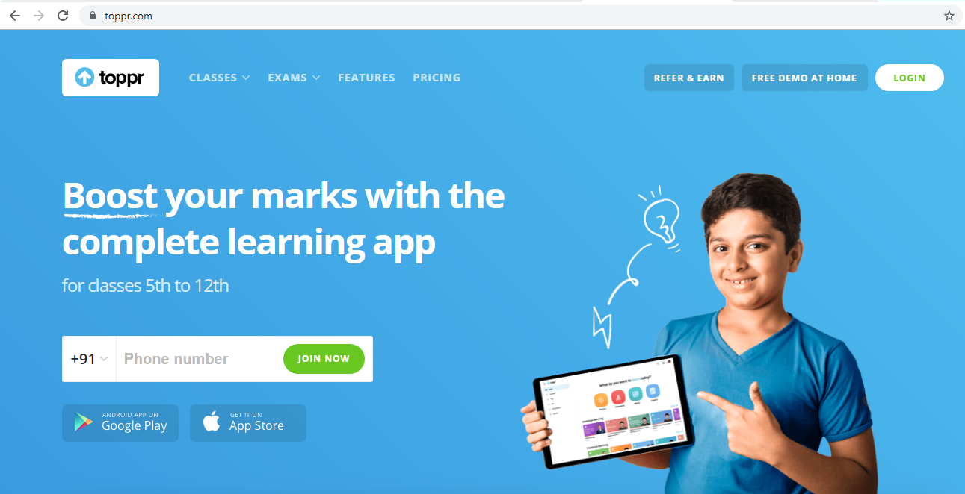
How can you login in Toppr.com (First time login with OTP)
1) Click login

Slide 13
Enter the required OTP received on registered mobile number and click on Login.
2) Enter OTP received on registered mobile number
77123456789

Slide 14
Steps for Student’s Activation

Slide 15
Thank you!

